Slide 1
CP5638 Workshop
Introduction

Slide 2
Assessment Items
Assessment 1: Portfolio of practicals 20%, Week 5 (1/3/2026; 11: 59p.m)
Assessment 2: Basic site, 30%, Week 6 (15/3/2026; 11:59 p.m)
Assessment 3: Multi-method:
  Full website : 30%, Week 10 (12/4/2026; 11:59pm)
  Research presentation : Oral 20%, Week 10 (12/4/2026; 11: 59p.m)
Notes:
Open LJCU Assessment Overview and explain the rubrics

Slide 3
Research Presentation (PowerPoint Presentation)
Workshops commence in Week 3, 6, and 9.
You will research and present your work during the last workshop session
  Face–to-face presentation
  15 mins presentation + 5 min Q & A

Slide 4

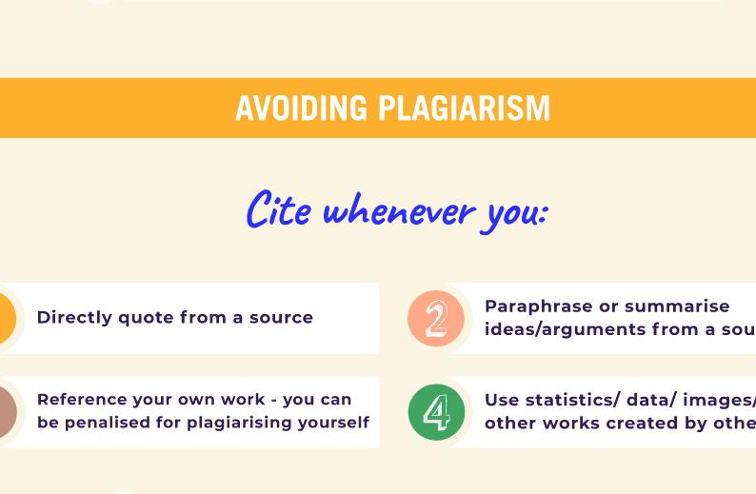
Academic Integrity & AI/GenAI
This Photo by Unknown Author is licensed under CC BY-NC
https://www.jcu.edu.au/ai-at-jcu/ai-for-students

Slide 5
Pick a topic
Accessibility (use by people with impairments of some sort)
Usability
Cultural aspects (how people use the app may vary depending on the user’s culture)

Slide 6
Searching for good conference/journal papers
For this subject, you can use
https://scholar.google.com/
Other resources, as long as they are reliable, i.e., not random/dodgy websites/sources.

Slide 7
Finding content for your PPT
Find conference/journal papers for workshop report
  Ensure that the selected papers are of good quality
    http://portal.core.edu.au/conf-ranks/
    http://portal.core.edu.au/jnl-ranks/
    Have a look at impact factor is a scientometric index that reflects the yearly average number of citations that articles published in the last two years in a given journal received.

Slide 8
Preparing YOUR PPT
Read your selected papers, articles, textbooks, etc
  Take notes
Create your PPT
  Background
  Motivation
  Synthesis
  Findings
  Conclusion

Slide 9
Referencing style
Your report should be well-referenced using academic sources such as peer-reviewed journals.
Use APA formatting for your reference list. See the library site for style examples: https://libguides.jcu.edu.au/apa

Slide 10
rubric
Upload your completed report into the LearnJCU Submission Box by 11.59pm Sunday of Week 10 (12/04/2026)
https://learn.jcu.edu.au/ultra/courses/_190589_1/outline/file/_9322355_1

